Slide 1
Implementing Computation Across the Curriculum
Todd Zimmerman
University of Wisconsin – Stout
Beyond the First Year Conference III - 2018

Slide 2
Talk Outline
Three-legged stool

Slide 3
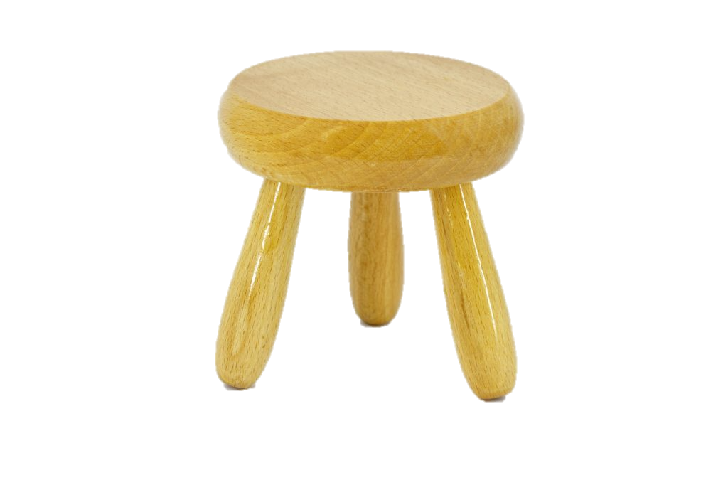
Three-Legged Stool
Physics
Theory
Experiment
Computation
[Three-legged stool]. (n.d.). Retrieved July 23, 2018, from https://marketvolt.com/2017/05/marketing-is-a-three-legged-stool/

Slide 4
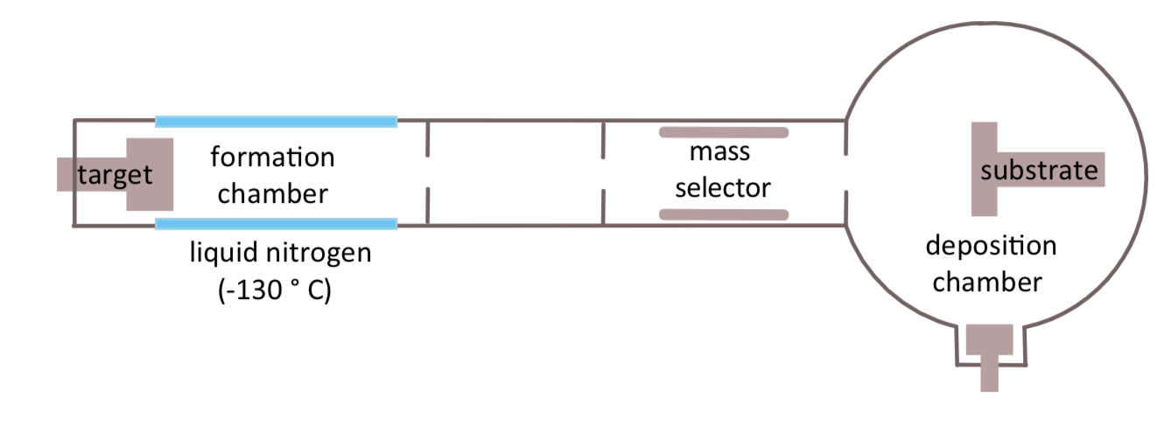
Inert Gas Condensation of Nanomagnets
How do magnetic nanoclusters form in argon plasma?
Computational modeling required
Notes:
2017 Nobel prize in physics was for observation of gravitational waves, which would not have been possible without computational data analysis
The 2015 prize in physics was for the discovery of neutrino oscillations, which again required significant data analysis and modeling.
Nobel prize in chemistry in 2013 was for computational modeling of molecules

Slide 5
Computation in the Workplace
A little less than half of bachelors graduates seek industry positions
Bachelors students in industry report 75%-90% are programming and 50%-60% are performing modeling and simulation
Based on 2017 AIP "Physics Bachelors: Initial Employment” report which is based on survey data from 2013-2014
Question: Who should we be serving and how do we best serve them?
Notes:
41% seek industry jobs while 54% go to grad school
Students in grad school obviously need to know programming too
Do we focus on the highest bar (grad-school-bound students) or on the broadest audience (grad school plus industry)

Slide 6

Partnership for the Integration of Computation into Undergraduate Physics - Goals
Create community of educators
Faculty development workshops
AAPT Workshops
Come to your department
Collect resources, strategies, and tactics to integrate computation across the curriculum
gopicup.org
Notes:
Founded by Norman Chonacky and David Winch

Slide 7
What does “integration of computation across the curriculum” mean?
Inclusion of computational projects and exercises across the various courses in the curriculum in an intentional and coherent fashion
Use computational physics thinking in all courses
Notes:
Using computers to conduct tasks that you couldn’t otherwise accomplish
Does not necessarily mean programming but rather making use of programs, however programming can make up an important part of the curriculum.
Includes everything from using simulations, having students modify working code, giving students templates to work from, all the way up to writing code from scratch

Slide 8
Computational Physics Thinking
Translate a model into code
Choose scales and units
Subdivide a model into a set of manageable computational tasks
Choose algorithms and computational tools
Debug, test, and validate code
Extract physical insight.

Slide 9
We’ve made progress
Amount of computation in curriculum has improved since survey in 2006
50% of departments report at least half of faculty members assigning computational homework and a similar percentage assigning computational projects
63% of departments have at least one faculty member requiring computational homework
In 2006 39% of departments reported 20% of faculty included computation in their grading
Less than 25% have half of faculty assessing computation on exams (35% report at least one faculty member doing this)

Slide 10
Slide Rules
By s58y (Keuffel & Esser slide rule, model 4081-3) [CC BY 2.0 (https://creativecommons.org/licenses/by/2.0)], via Wikimedia Commons

Slide 11
Possible ALpHA/PICUP Immersion in 2019
Contact Lowell McCann or Kelly Roos for more information.

Slide 12
Talk slides and links to references at:
Thanks to the following for funding:
Dept. of Chemistry and Physics, UW-Stout
College of Science, Technology, Engineering, Mathematics, and Management Dean

